Slide 1


BDCC Workshop
Typical day of a big data engineer
https://github.com/DmitryKober/bigdata-workshop.git
March 2018
by Dmitrii Kober

Slide 2

AGENDA
1
BigData Overview
2
Problem Context
3
Case Study

Slide 3
BIG DATA Overview

Slide 4
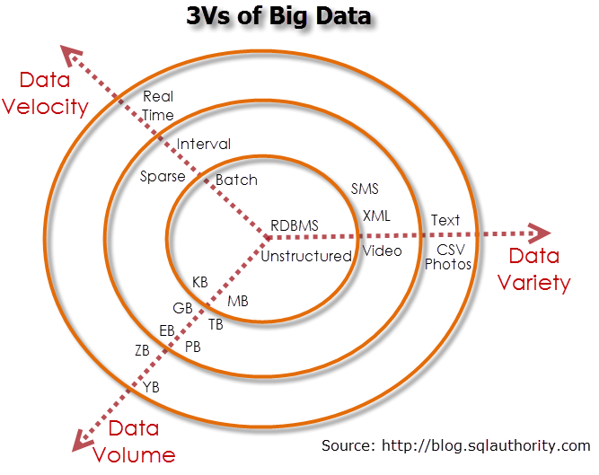
{Prerequisites #1

Slide 5
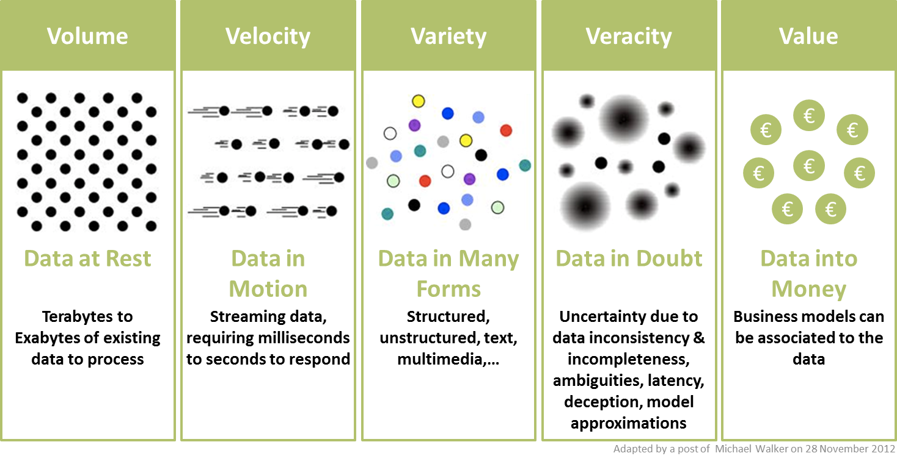
{Prerequisites #2

Slide 6
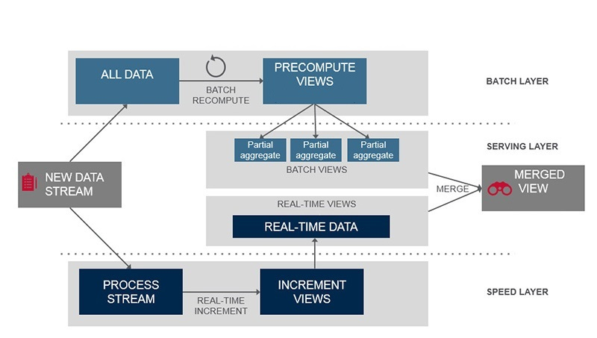
{Big Data approach: Lambda Architecture

Slide 7
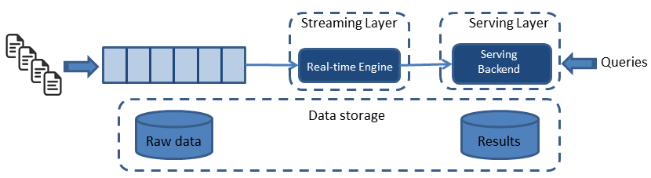
{Big Data approach: KAPPA Architecture

Slide 8
Case study

Slide 9
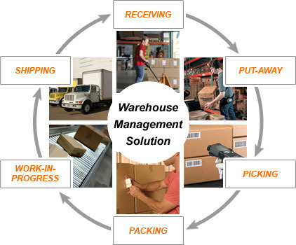
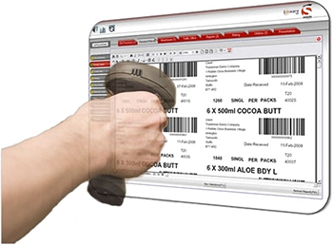
Warehouse management service

Slide 10
{Problem Context
!
!
BUSINESS ITEMS TO CONSIDER
TECHNICAL ITEMS TO CONSIDER
Member Application Solution shall support a large number of organizations, each with its own members, business partners, customizations, preferences and application usage specifics.
All data updates have to pass review/approve lifecycles before being actually applied.
The problem of calculating fair commissions to be charged from tenants, based on their shares in the system utilization.
The solution has to be cloud-ready, cost and resource effective, highly-available (99.9%), fault-tolerant, scalable, performant and ensuring tenant data isolation and protection.
The solution architecture has to be sustainable, well-integrated with the existing X-Customer’s enterprise architecture and comply with X-Customer’s policies and standards.
Not only human-beings, but also automated 3’rd party systems shall be using the platform.

Slide 11
Solution Overview

Slide 12
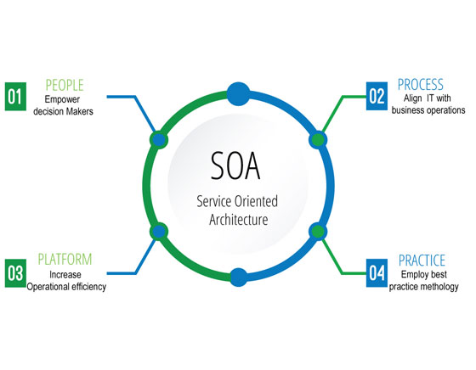
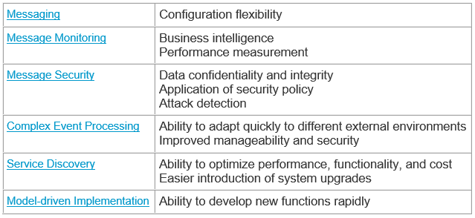
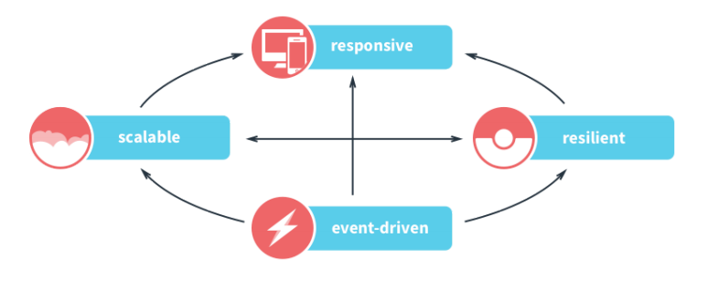
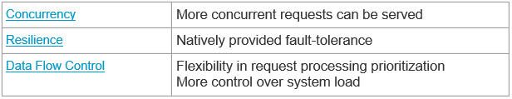

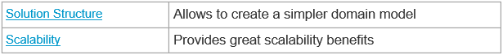
Solution Presentation: Overview
The solution is inspired by:
Profit:
SOA
Reactive Architecture
Decoupling Reads and Writes

Slide 13
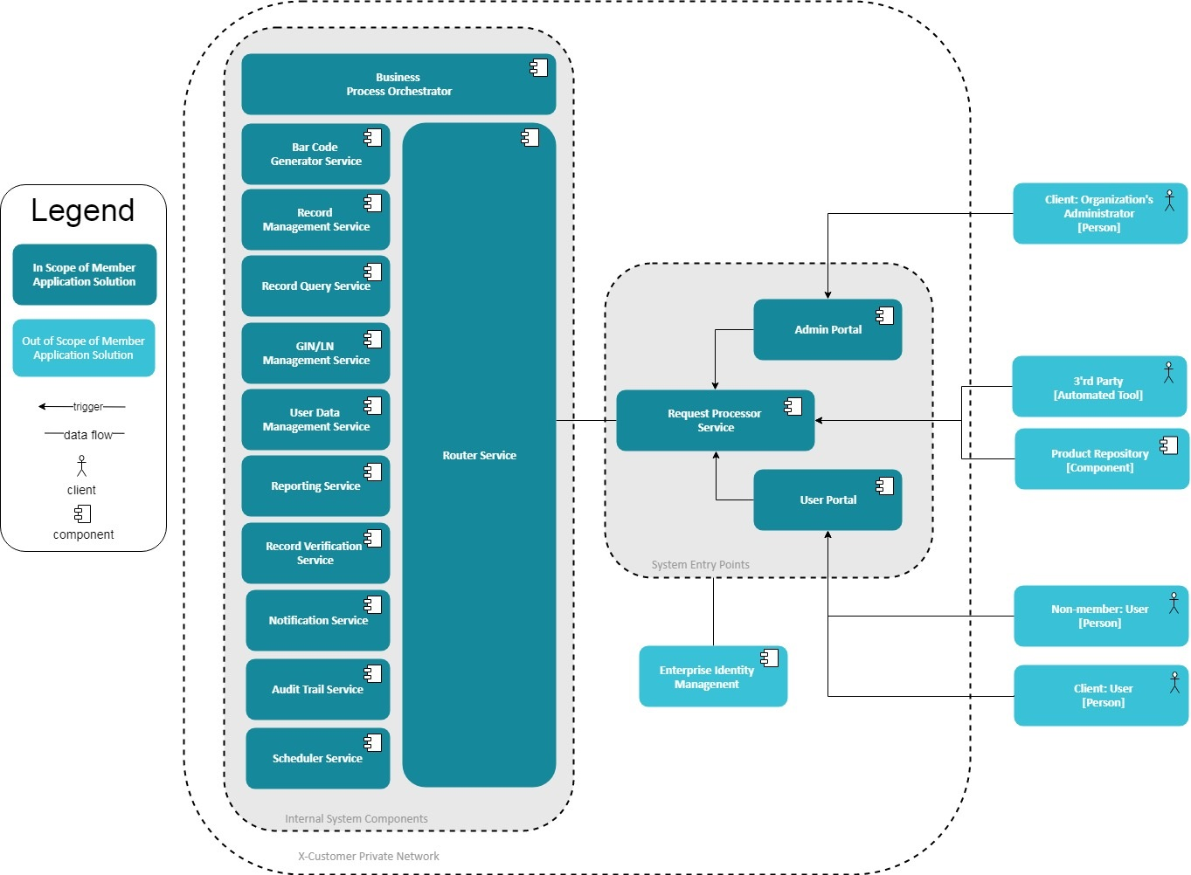
Solution Presentation: Overview
The solution is inspired by:
SOA
Reactive Architecture
Decoupling Reads and Writes

Slide 14

Solution Presentation: Rationale
BENEFITS
Scalability
High-availability
Security
Performance
Fault-tolerance
Flexibility

Slide 15
Narrowing down https://github.com/DmitryKober/bigdata-workshop.git

Slide 16
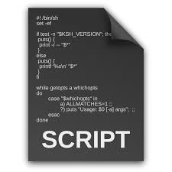
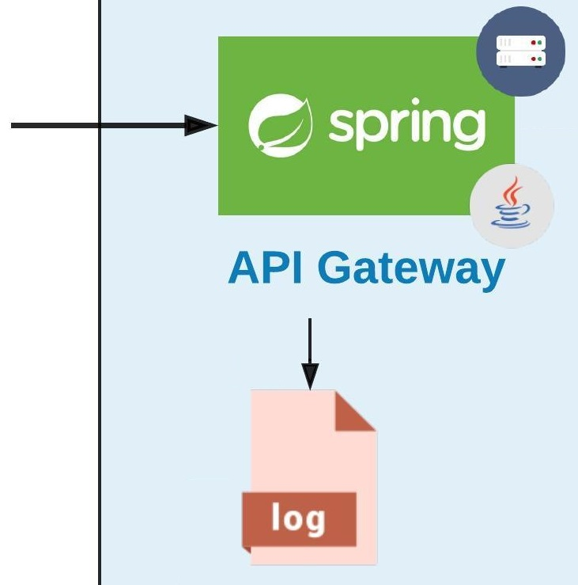
API gateway

Slide 17
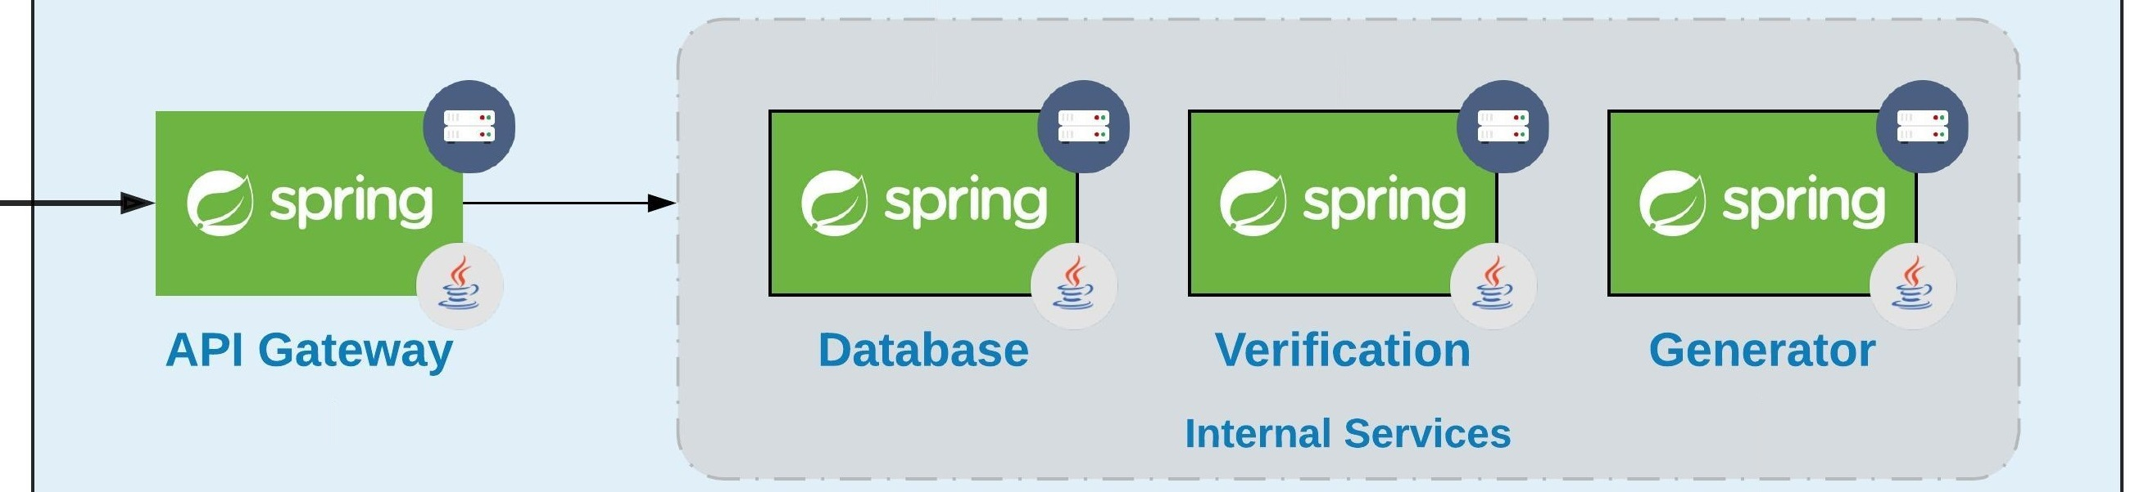
Let’s Introduce a couple of Services

Slide 18
how about communication? Are there any problems?

Slide 19
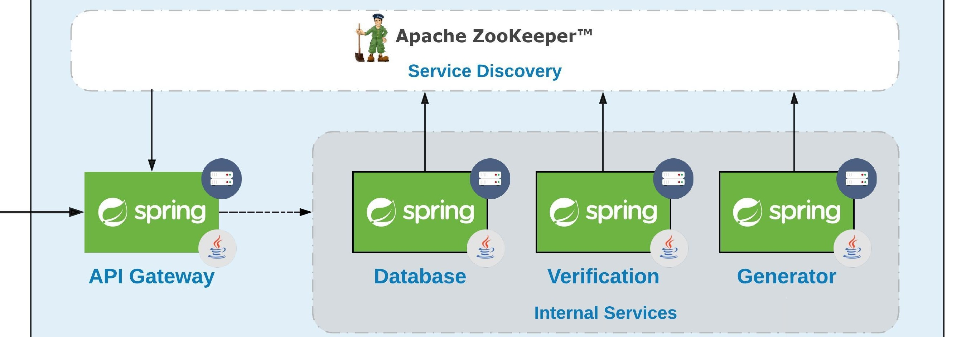
Service Discovery to the rescue!
!

Slide 20
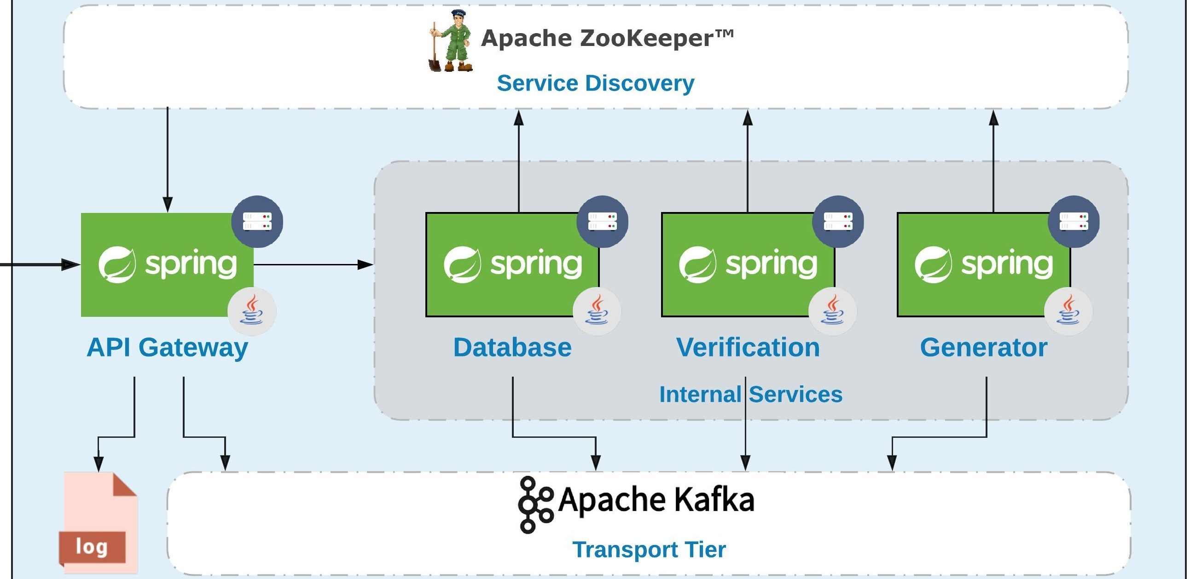
So we have ‘reactive soa’. What about Messaging?

Slide 21
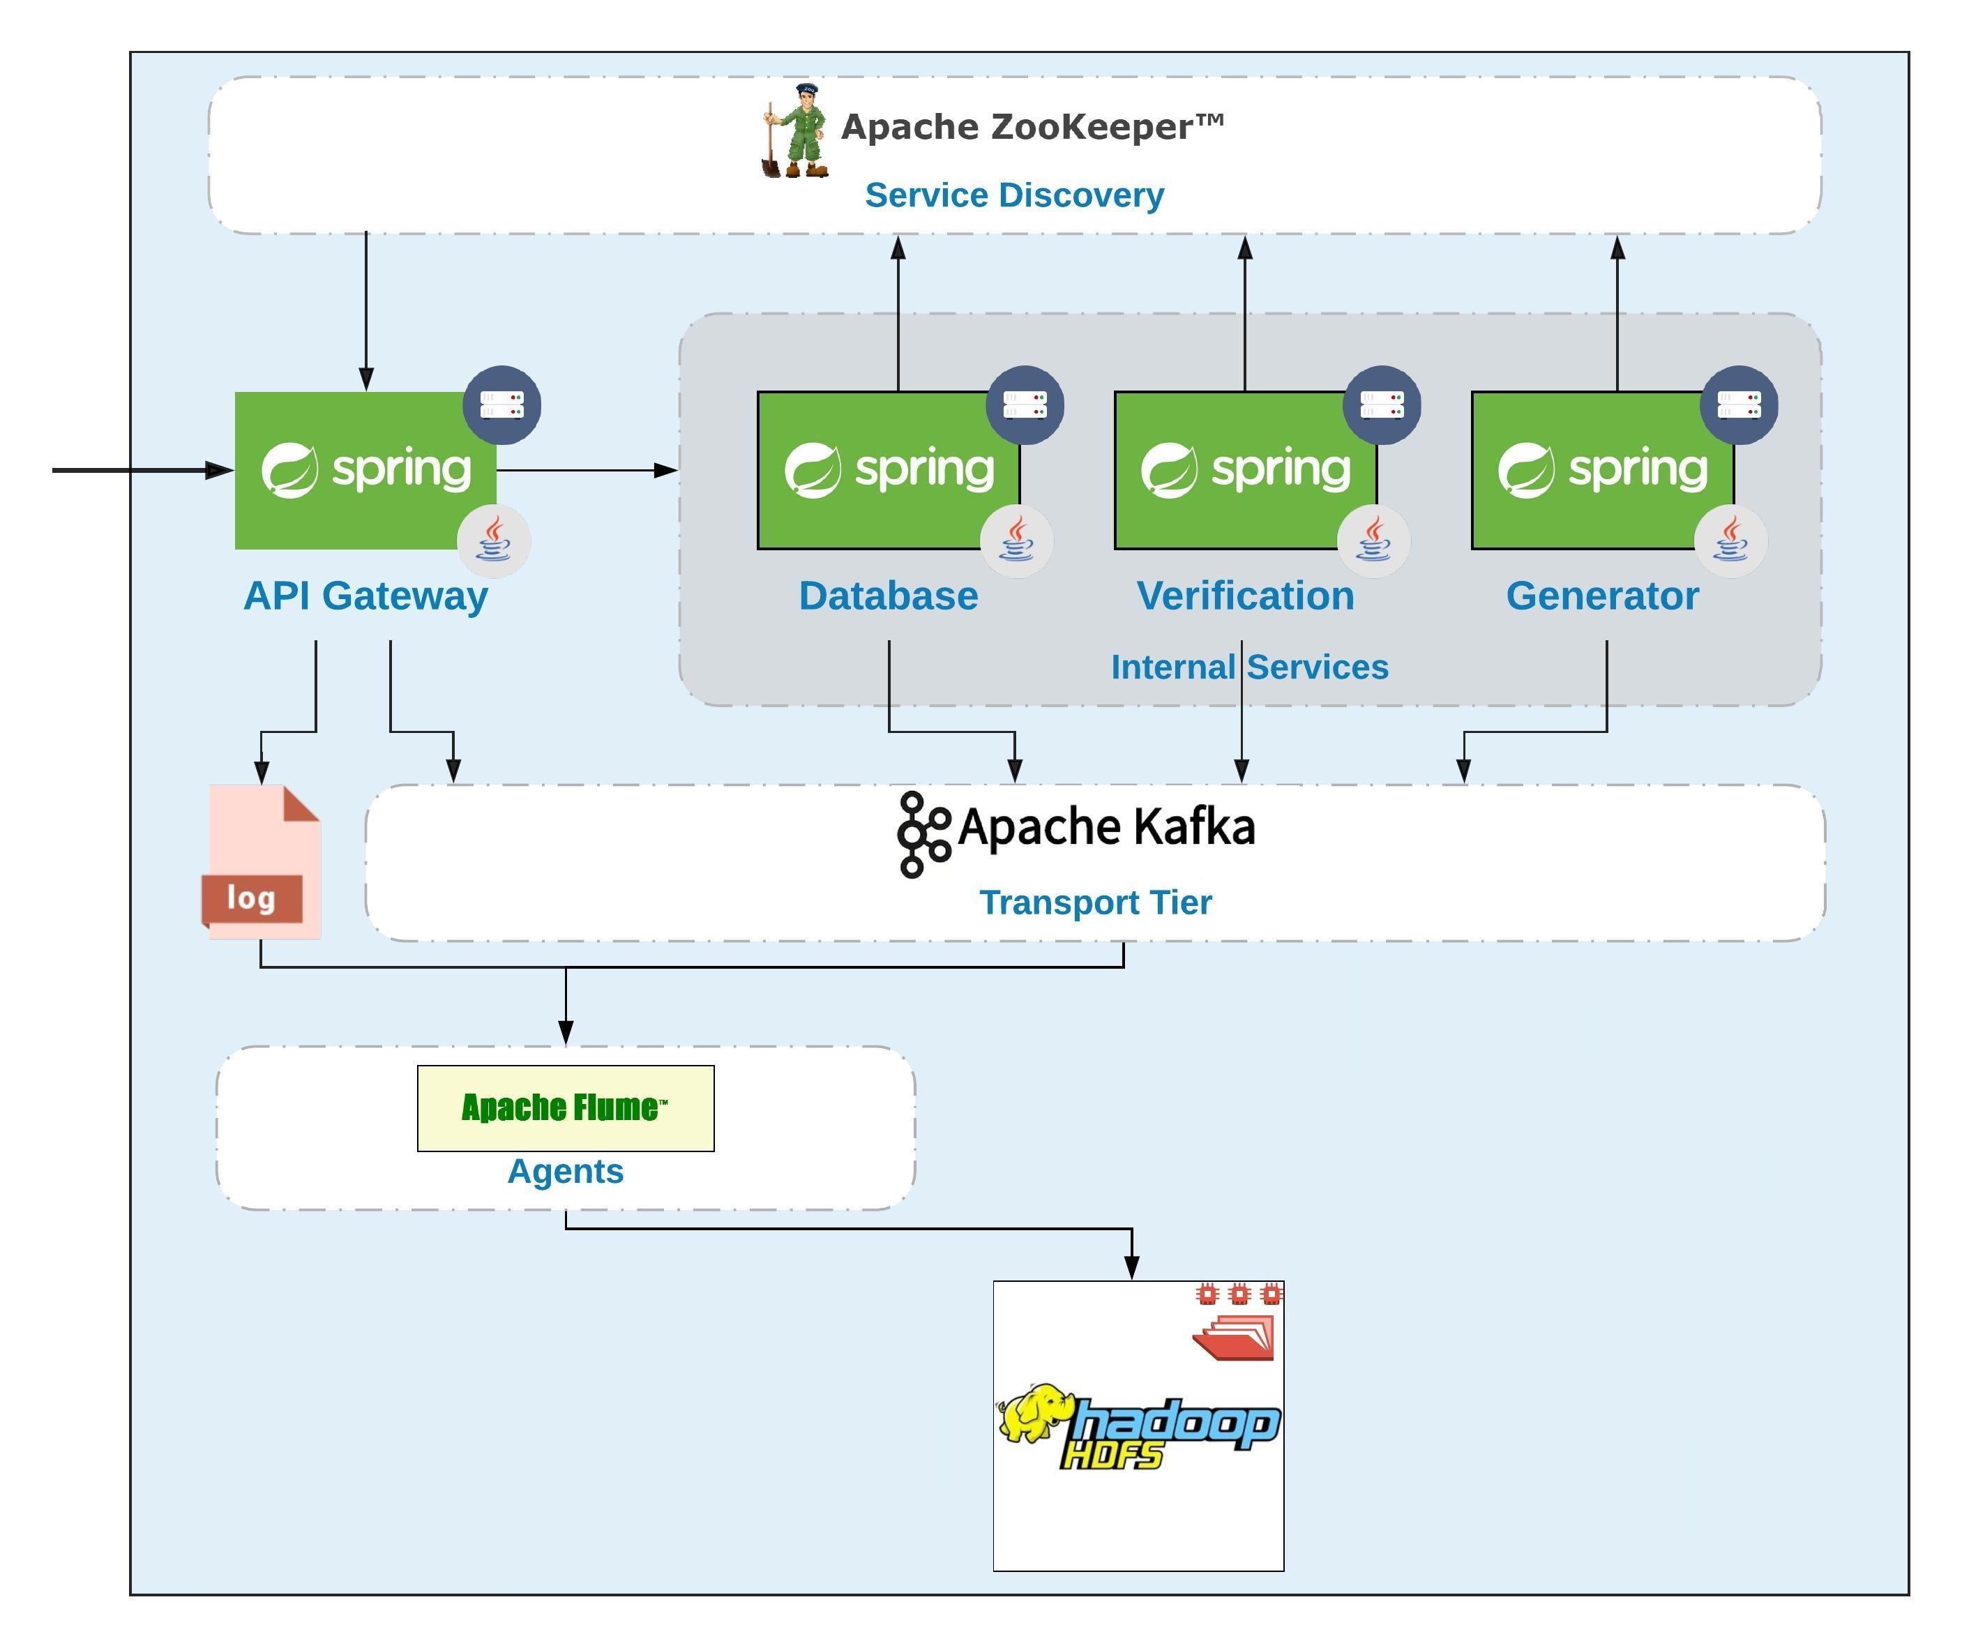
Now its time for batch layer

Slide 22
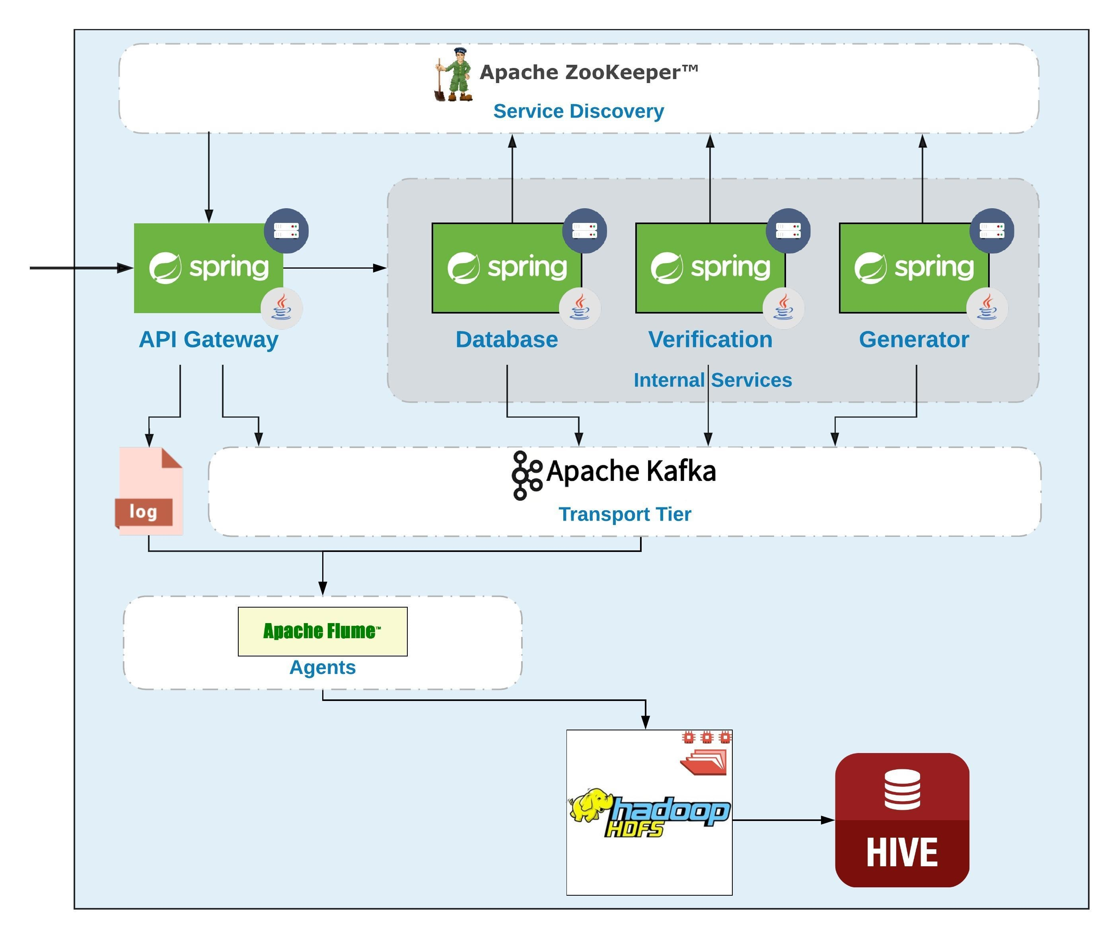
Let’s Add some Data analysis

Slide 23
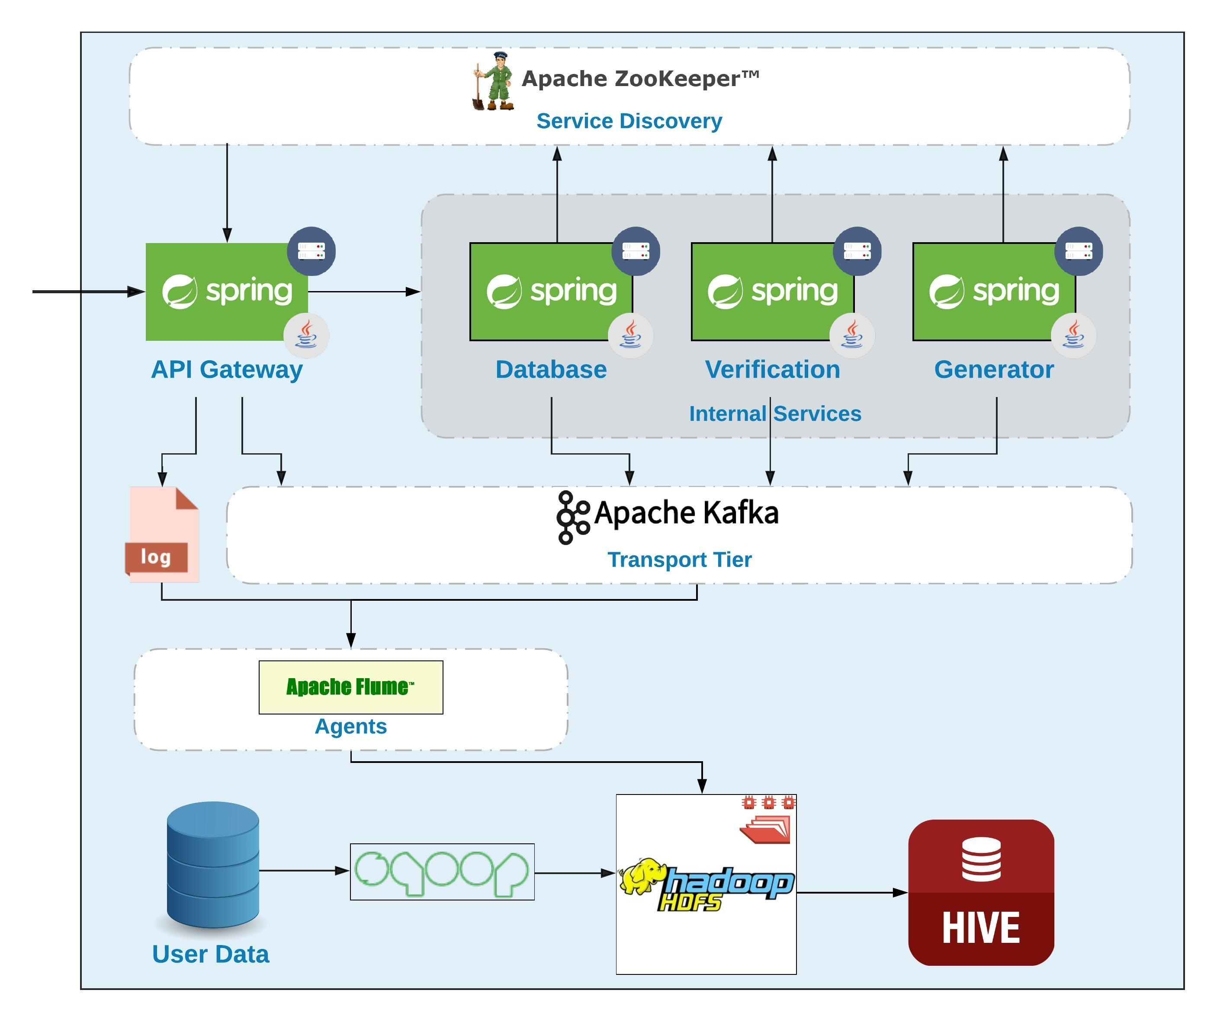
Here Variety Comes…

Slide 24
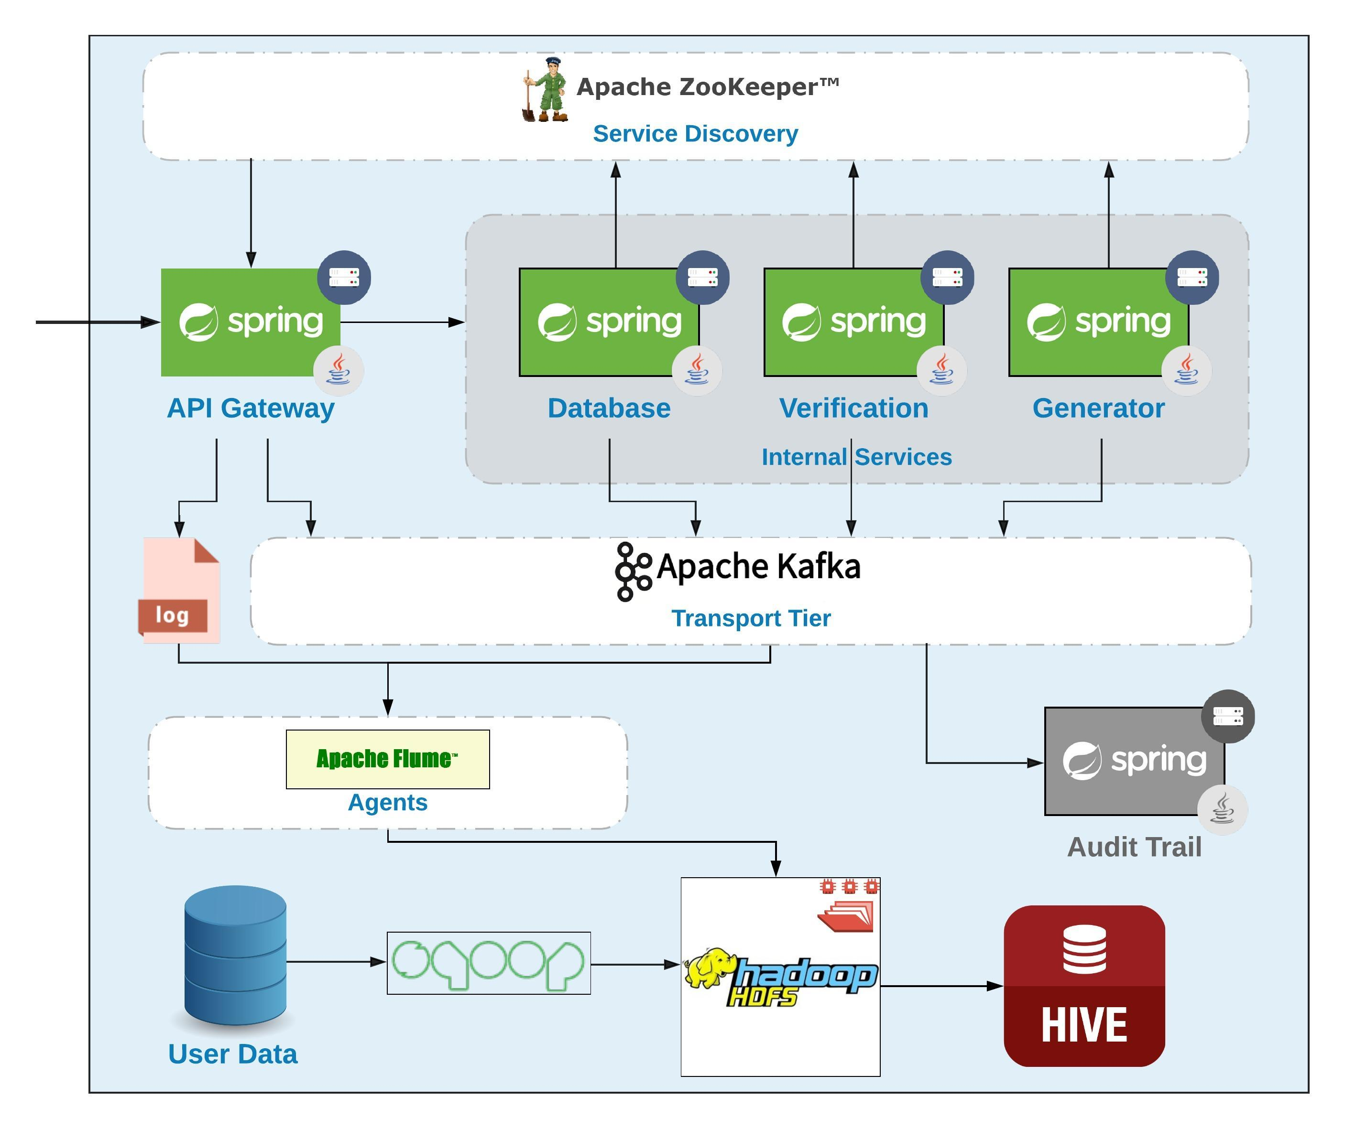
Realtime Layer? Your Turn ;)

Slide 25

Thank You!

